Slide 1

Digital Portal Project
The Digital Portal project is designed to establish a centralized online platform that empowers users to effectively present their skills, projects, and experiences. In today's digital age, this platform will facilitate personal branding and professional networking, allowing individuals to connect and engage with a wider audience.

Slide 2




Student Information
Register No
Student Name
2422k1450
Manigandan D
NM ID
Email
D817C8BBB27524CAFB249C79BF21B4A3
manigandandnm2422k1450@gmail.com
IBM SKILLBUILD EMAIL ID
Department
manigandandnm2422k1450@gmail.com
BSc Computer Science
College
Government Arts and Science College, Sathyamagalam, Bharathiyar University

Slide 3







Digital Portfolio Project Overview(1)
Problem Statement
Project Overview
A clear description of the issue or challenge that needs to be addressed.
A brief summary of a project's goals, objectives, and key details.
Features and Functionality
End Users
*Feature*: A distinct characteristic of a product or system.
*Functionality*: The capabilities or actions it can perform.
The person who ultimately uses a product or service
Tools and Technologies
Portfolio Design
Software, hardware, or equipment used to perform specific tasks or achieve particular goals.
Creating a curated collection of work showcasing skills and accomplishments.

Slide 4

Digital Portfolio Project Overview(2)
Conclusion
A summary of key points and final thoughts.
Results and Screenshots
Outcome of a process with visual evidence.
GitHub Link
URL linking to a repository or project on GitHub.

Slide 5





Digital Portfolios: A Solution for Visibility
1
Traditional Resumes Limit Visibility
2
Lack of Online Presence
3
Digital Portfolios Offer Solutions
Limited or no visibility on digital platforms, making it hard to reach a wider audience.
Traditional resumes can be limiting in terms of visibility, especially with applicant tracking systems and online job platforms.
Showcase work, skills, and accomplishments online, increasing visibility and accessibility.

Slide 6

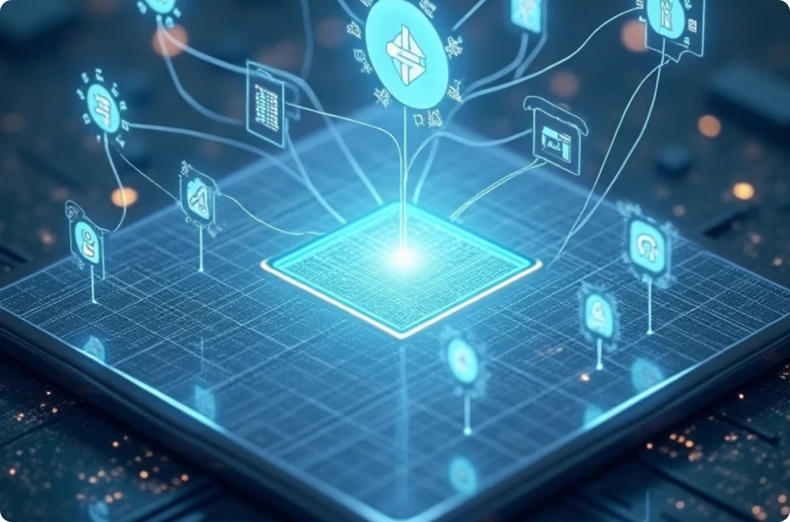
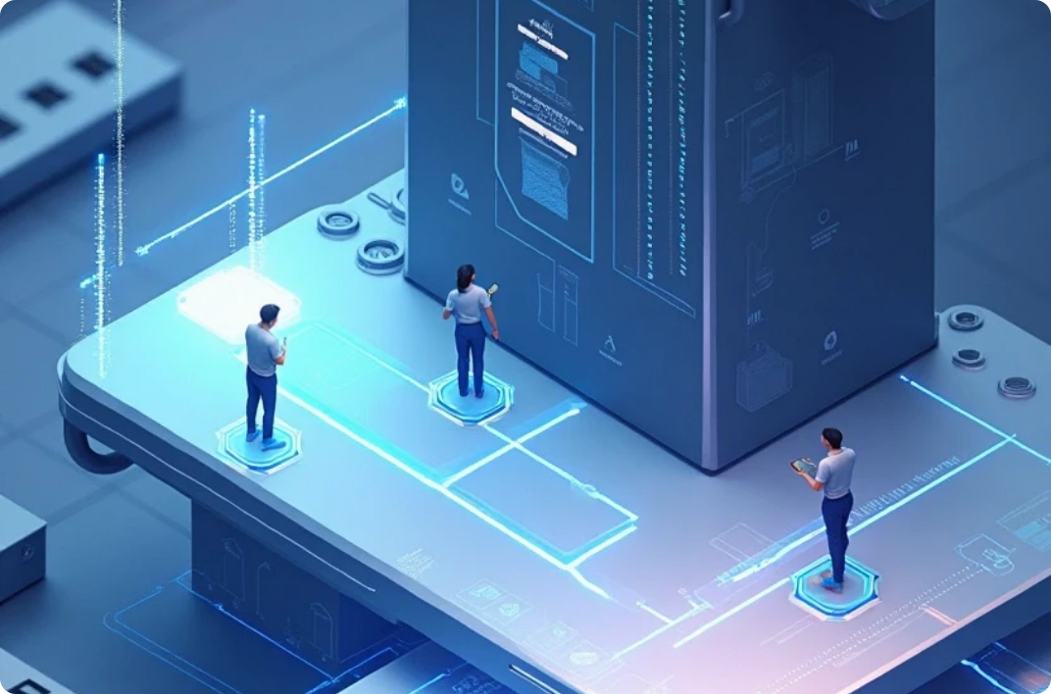

Digital Portal Project Overview
Centralized Access
Enhanced User Experience
Scalable Foundation
Single-point entry or control, streamlining management and security.
Intuitive, seamless, and engaging interactions that meet user needs and expectations.
A flexible and adaptable base that supports growth, expansion, and increased demands.

Slide 7





End Users
Students
Professionals
The ultimate target audience for educational products, services, or systems, directly benefiting from or impacted by their and functionality.
1
2
Experts or specialists who utilize a product, service, or system to achieve specific professional goals, enhance productivity, or perform complex tasks.
Employers
Educators
Individuals within an organization who directly interact with and utilize a product, service, or system to perform their job functions.
4
3
Teachers, instructors, or trainers who utilize a product, service, or system to support teaching, lesson planning, and student learning outcomes.

Slide 8



Tools and Technologies
1
HTML
2
CSS
HyperText Markup Language, a standard markup language for creating web pages.
Cascading Style Sheets, a styling language used to control layout and visual appearance of web pages.
3
JavaScript
4
Frameworks
A high-level programming language used for client-side scripting, creating interactive web pages, and dynamic user experiences.
Pre-built structures or sets of tools that provide a foundation for building applications, simplifying development and standardizing code.

Slide 9


Features and Functionality
User Profiles
Project Uploads
Search Functionality
Data and settings defining a user's identity and preferences within a system or application.
Transferring project files and data to a server, platform, or system for storage, sharing, or deployment.
A feature that enables users to find specific content, data, or information within a system, application, or database.
Feedback System
Share Options
A mechanism that collects and analyzes user input, opinions, or ratings to improve performance, quality, or user experience.
Features that allow users to distribute or share content, files, or information with others through various channels or platforms.

Slide 10



Conclusion of the Digital Portal Impact
1
Effective Platform
2
Enhanced Visibility
3
Future Developments
A system or environment that efficiently achieves its intended purpose, providing a seamless and productive experience for users.
Increased awareness, exposure, or prominence of a product, service, or brand, making it more noticeable and accessible to the target audience.
Planned or potential upgrades, improvements, or innovations that will be implemented in the future to enhance a product, service, or system.

Slide 11

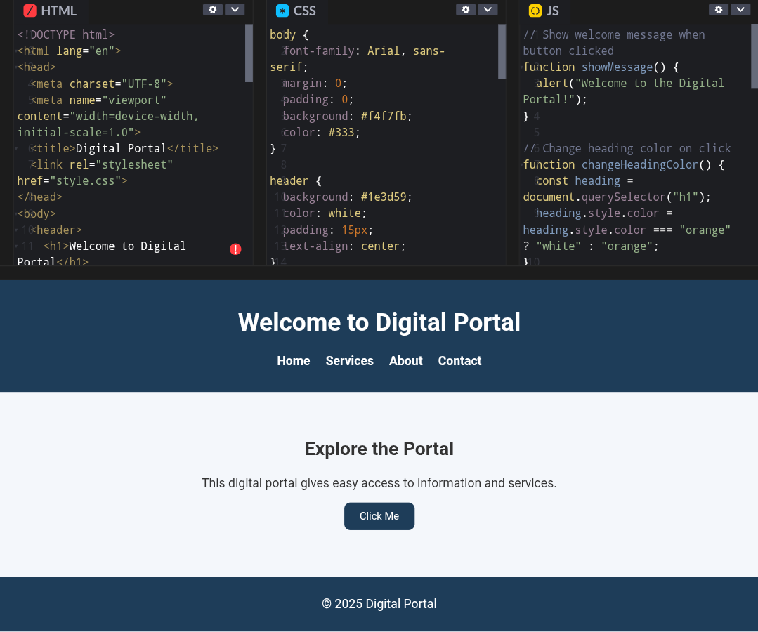
Results and Screenshots

Slide 12

GitHub Repository for Digital Portal Project
Visit Repository
Get Source Code
Contribute to Project
Access the central hub for code, files, and collaboration.
Access the underlying code that powers
the application or system.
Collaborate on and add value to
a shared project or initiative.

